Slide 1

Coding with AAUP
Free PowerPoint template
By: Hussein Younis
2023

Slide 2

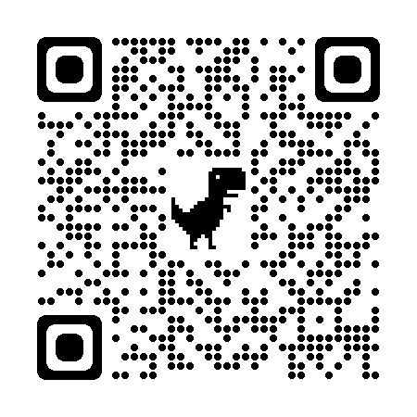
Download GitHub Desktop :
https://desktop.github.com/

Slide 3

GitHub Desktop installation:
Sign in using your GitHub profile

Slide 4
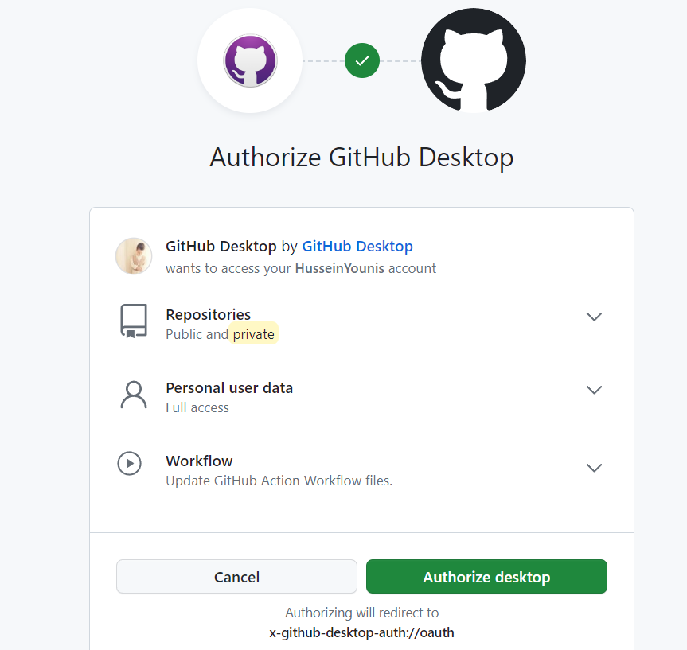
GitHub Desktop installation:
Click here

Slide 5
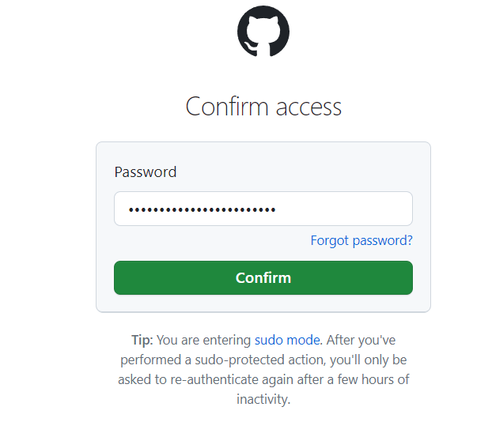
GitHub Desktop installation:
Fill in your password and then press confirm

Slide 6
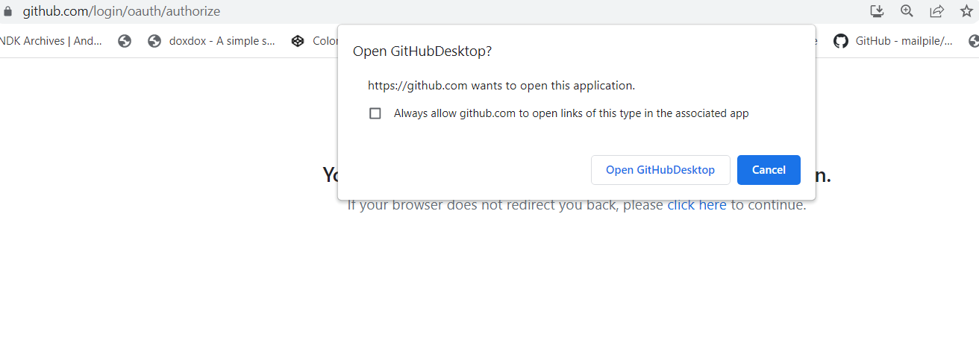
GitHub Desktop installation:
Click on open githubdesktop

Slide 7
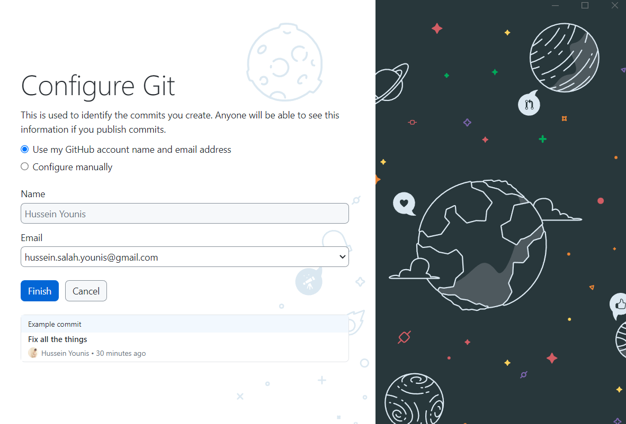
GitHub Desktop installation:
Click on finish

Slide 8
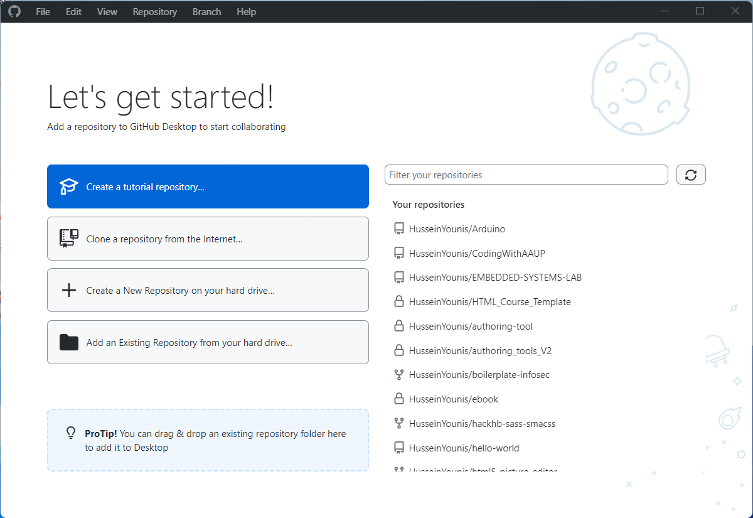
Lets get started!

